Slide 1

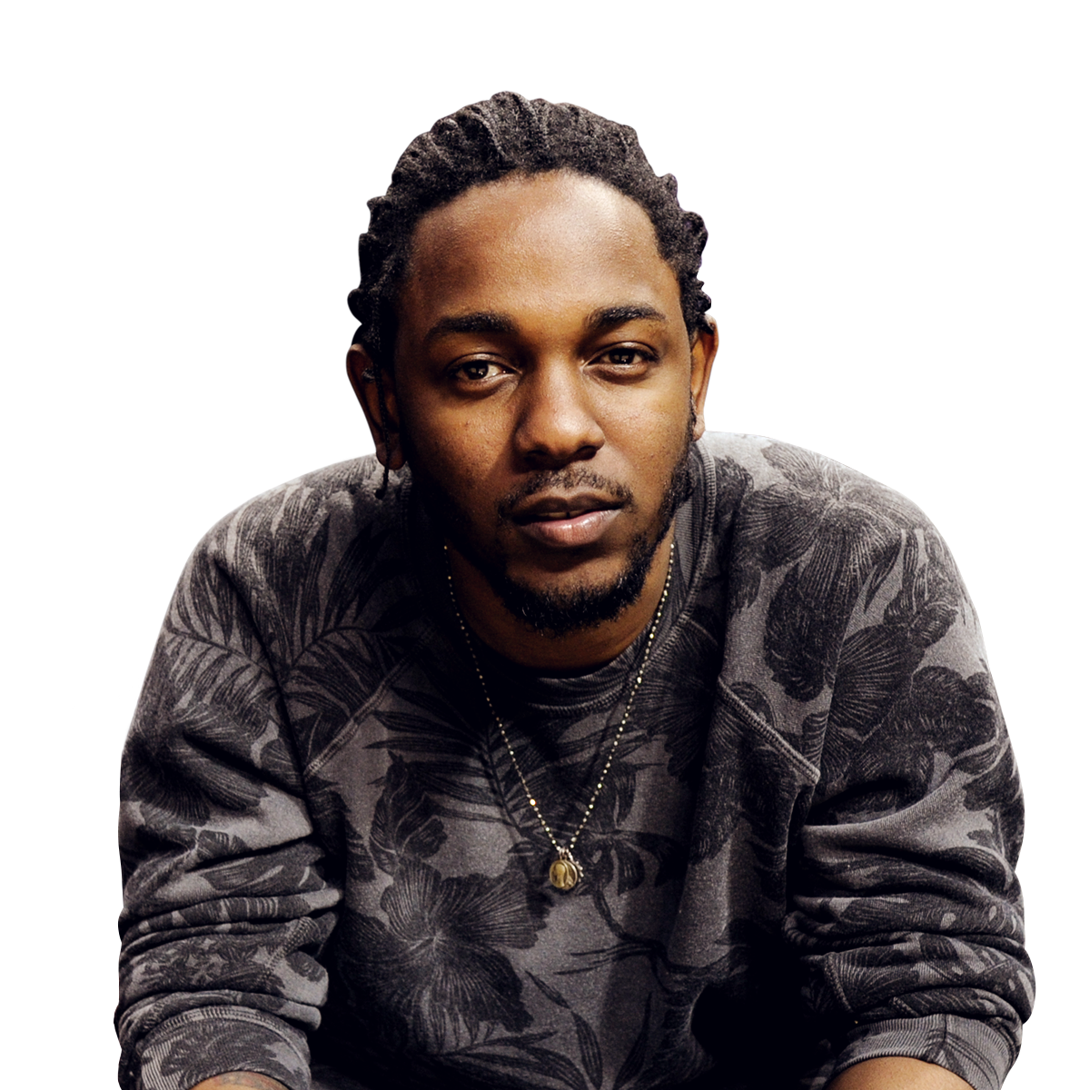

Music playlist generator
By: Peyjmon Ahmad
Notes:
Hi, Im Peyjmon Ahmad and I worked on a music playlist generator. I love listening to music, and I’m sure a lot of you guys do too. The problem is, that none of us want to waste our time listening to music we don’t actually like. So I sought to find a solution to this problem.

Slide 2
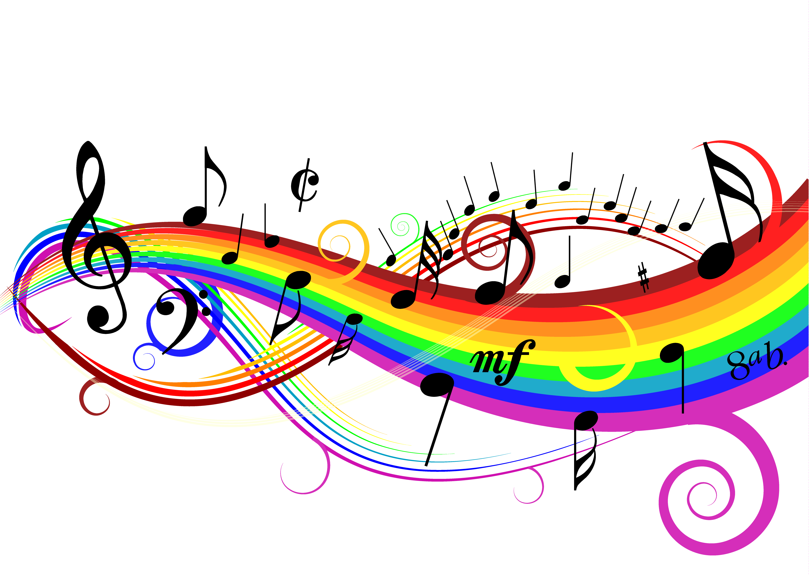
Objective
Gather thousands of songs from artists last 2-3 albums
Hip hop, R&B, Country, and Rock
Find the songs with the closest lyrical and audio similarities
Generate optimal playlists of 10-15 songs each
Notes:
So my objective was to gather thousands of songs from artists across these 4 genres, and find out which songs had the closest lyrical and audio similarities. And then ultimately, I wanted to generate playlists of about 10-15 songs each.

Slide 3









Tools
Data Sources
Notes:
Here are the tools and data sources that I used to get this done, gensim was very important for natural language processing in my text data. While the spotify api gave me access to all song and artist information, and lyric wiki allowed me to gather all my lyrics.

Slide 4
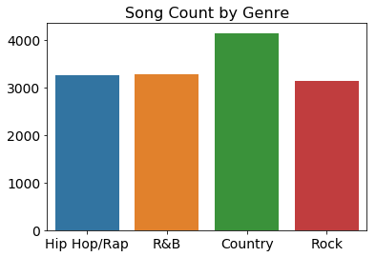
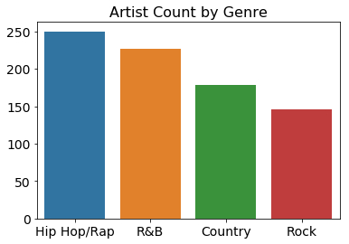
Data distribution
Total artists: 800
Total songs: 14,000
Songs per artist: 17.5
Notes:
Here’s a little bit of how the distribution of my data went. As you can see it was pretty evenly spread and it comes out to about 200 artists per genre and 17.5 songs per artist.

Slide 5
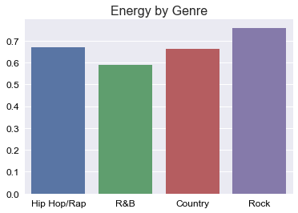
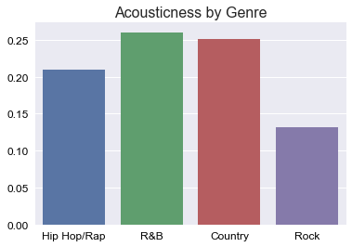
Audio features

Slide 6
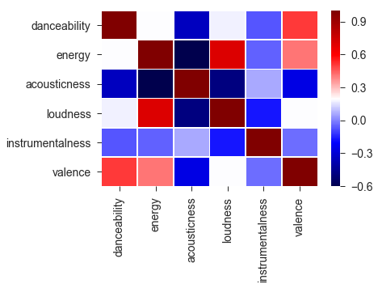
Audio feature Relationships
High acousticness = Low danceability
High acousticness = Low energy
High danceability = High valence
Notes:
I just wanted to point out a few key audio relationships in the data. Dark blue indicates a high Negative correlation,So generally with a high acousticness, you can expect see very low danceability and energy, while a high danceability will typically mean high valence, which is a measure of how positive the mood of the song is. I will talk more about this in a bit.

Slide 7
Modeling process
Lyrics Playlist
LDA (Topics)
Word2Vec (Context)
Nearest Neighbors
Audio Playlist
Correlation
Standard scaling
Nearest Neighbors
Combined Playlist
Notes:
And this is how the modeling process played out. For the lyrics playlist I used LDA to generate major topics, and Word2Vec which was import for modeling context, and then finding the shortest distance with nearest neighbors. The audio playlist was pretty straightforward, as the features were already in numbers rather than text. And then I combined both of these playlists into a balanced playlist of both.

Slide 8
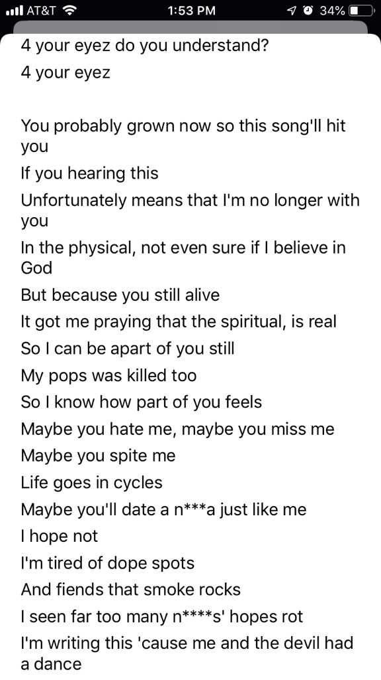
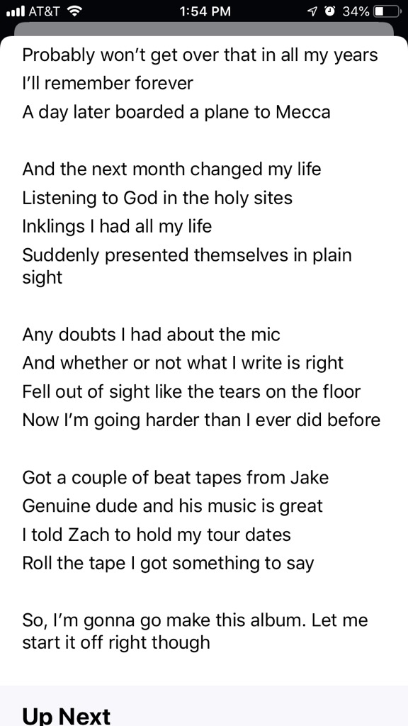
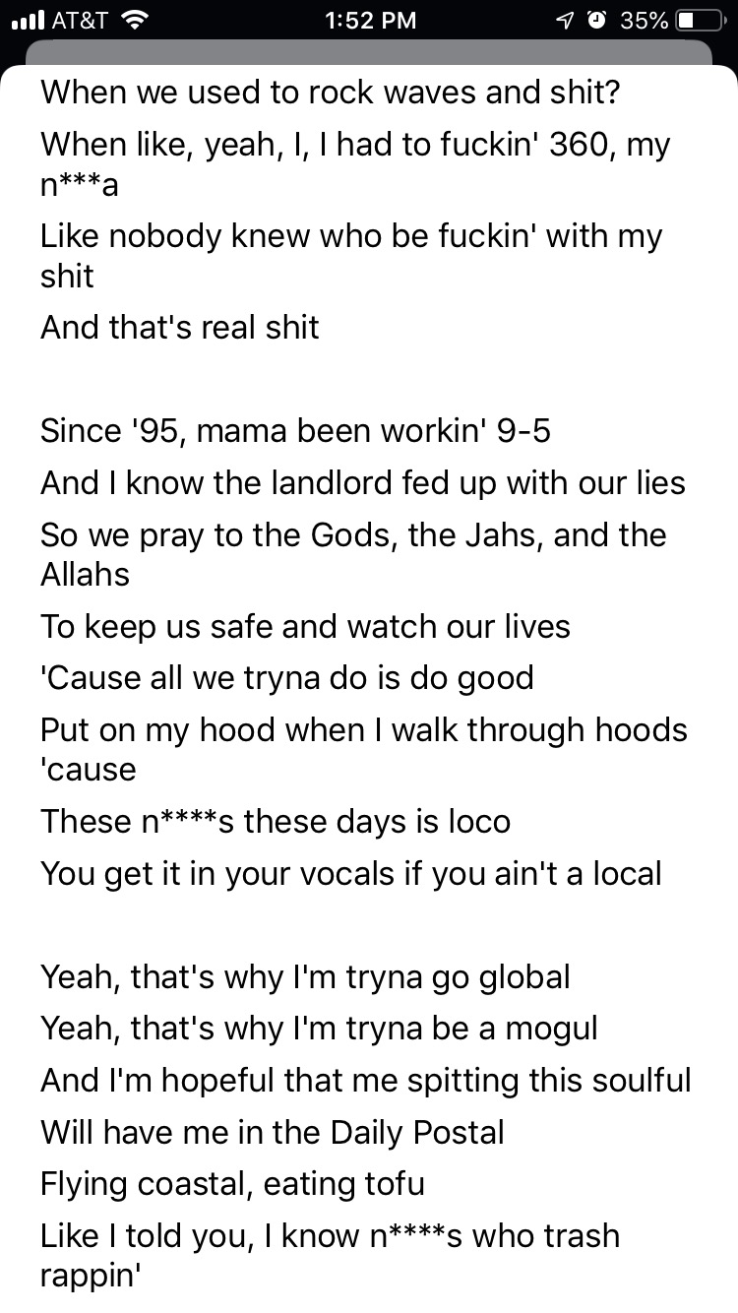
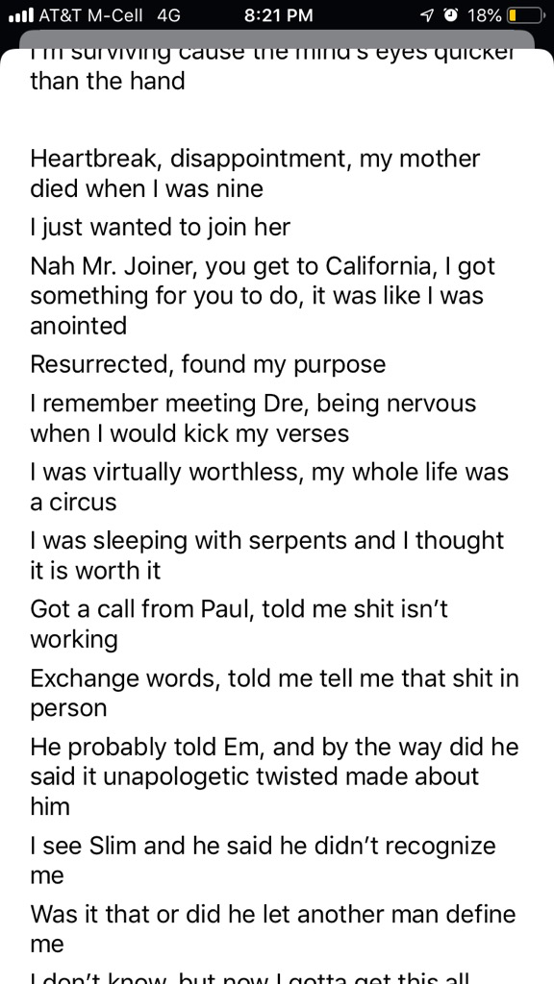
Lyrical neighbors
J.Cole- 4 Your Eyez Only
Brother Ali - Stop the Press
Pro Era- Waves
Xzibit- 1983
Notes:
Here is how my lyrical playlist would work, so you can see the song here 4 Your Eyez Only by J.Cole. If you take a quick glance you can see its about praise in god, a family member dying. If we input this into the model, you can see that it generates these songs with a similar message in regards to praising god and family members.

Slide 9
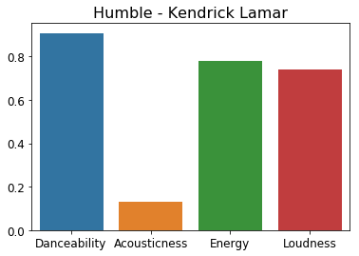
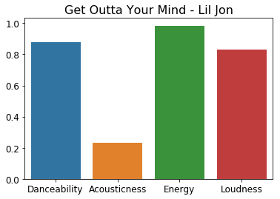
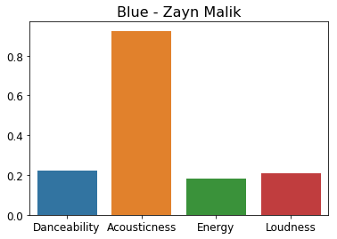
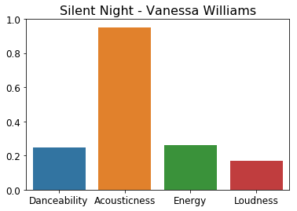
Audio neighbors
Notes:
And now to the audio features. Here are the features danceability and energy that I mentioned before. So if we input the song Humble my kendrick lamar into a model, there is a much higher probablity that we end up with a song like Get outta your mind by Lil Jon, due to similar features. On the contrary you can see the song blue by Zayn malik, has opposite features, so we can expect a song more in the likes of silent night by vanessa williams.

Slide 10
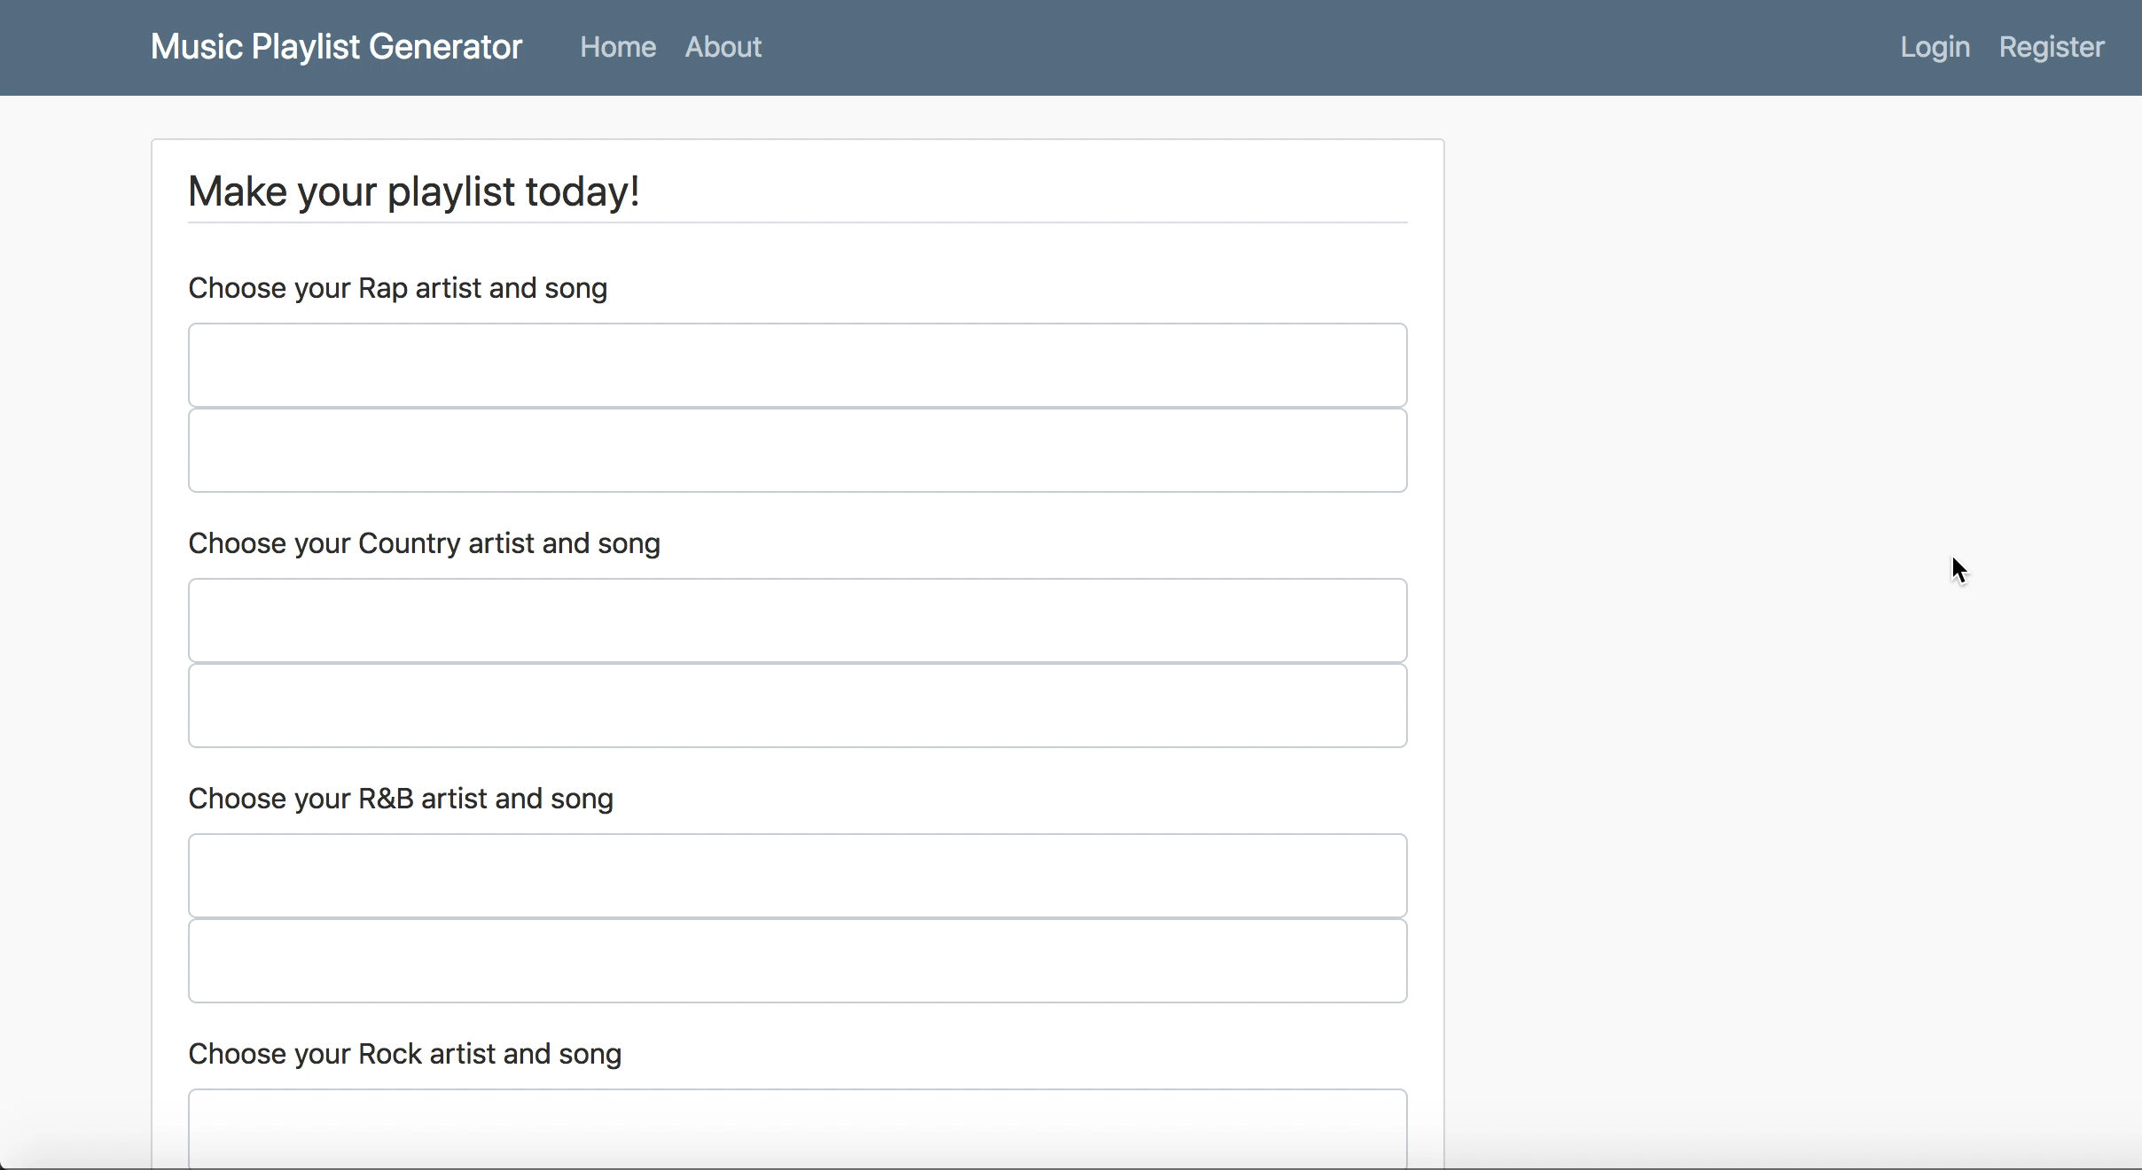
Notes:
Now I’m gonna show my web application that demonstrates everything we’ve gone over. So you can see here you have an option to enter an artist and song for 4 different genres. But if you scroll down the bottom, you can type in an artist and song for any genre. And it’ll find a playlist combined all 4 of these genres. So as an example, were gonna search one of my favorite songs Stargazing by Travis Scott. I love this song, but I actually don’t know many songs quite like it. So we’ll see if my generator can give me something to listen to. You can see here the first playlist generated is solely based on lyrics. So its all based on context and meaning in the song. If you scroll to the next playlist. You will see a playlist that is from similar audio features. So all those features we talked about like danceability, energy, and acousticness. Lastly, if you care about lyrics and audio equally, you can have it all with the best of both worlds playlist. Which has a fair balance between both features, if that’s what your looking for.

Slide 11




Thanks For Listening!
Peyjmon Ahmad
peyjmonahmad
peyjmon.a@gmail.com
Notes:
And that’s all I have you guys today, thank you for listening! Here is some of my information and if you have any questions please let me know.

